Slide 1
how much alpha helps

Slide 2
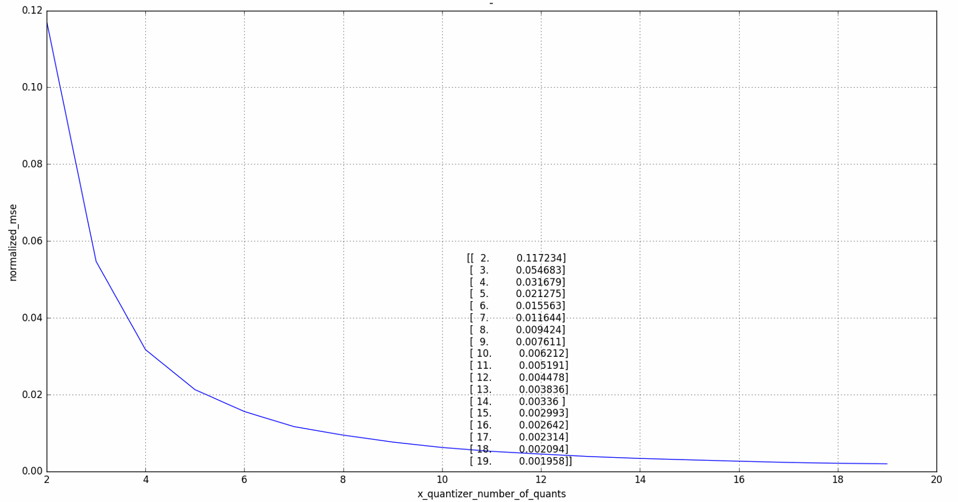
mse per number of quants with alpha

Slide 3
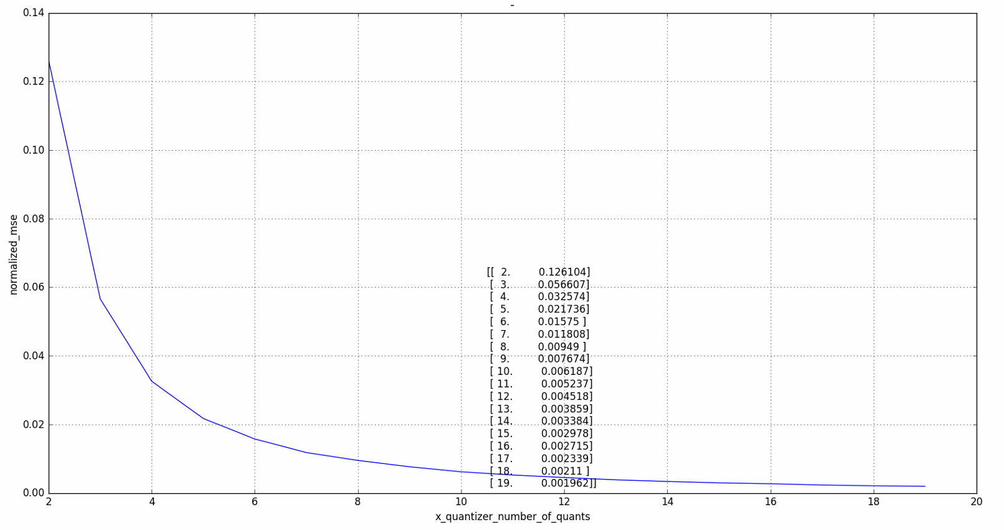
mse per number of quants without alpha

Slide 4
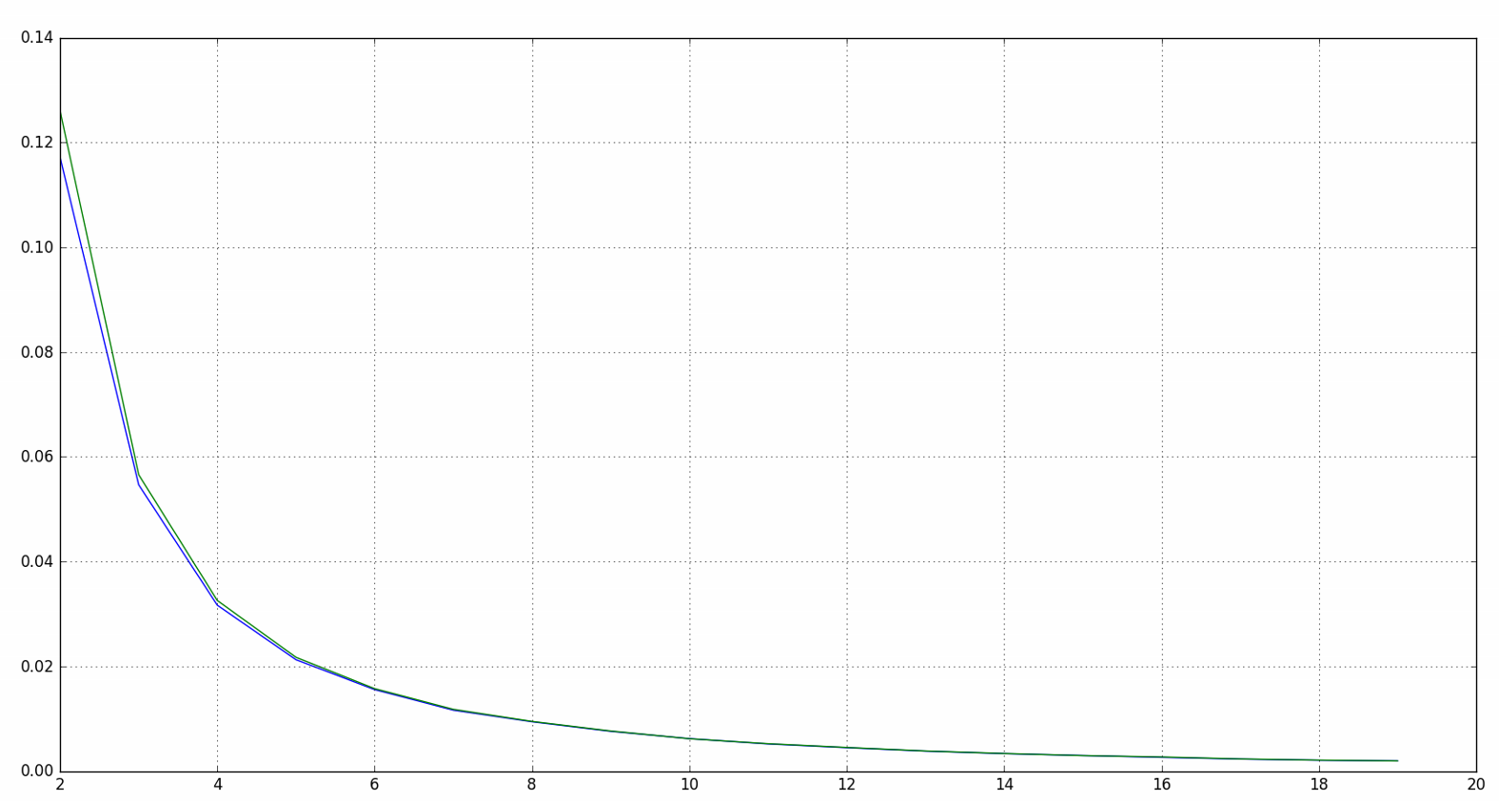
with vs without alpha

Slide 5
modulo size
modulo size is about the same at with and without alpha
you can see zig zag, I think it’s because at odd number of quants we have a quant at 0 and at even number we don’t have at 0
the simulation is looking for the best modulo size by the mse, so it might be that we have some error, because if for example at modulo size of 5.5 we got 0.11% of the samples to be outside of the modulo, and at modulo size of 4.5 we got 0.12% samples that are out of modulo, the out of modulo samples have more impact on the mse than other samples, and the simulation will take size 5.5.
so we might get big jumps because one of the simulation got lucky
as we randomize more samples we will get less of this error. I only manage to run 4e6 samples per modulo size, so this might explain the not perfect zig zag

Slide 6
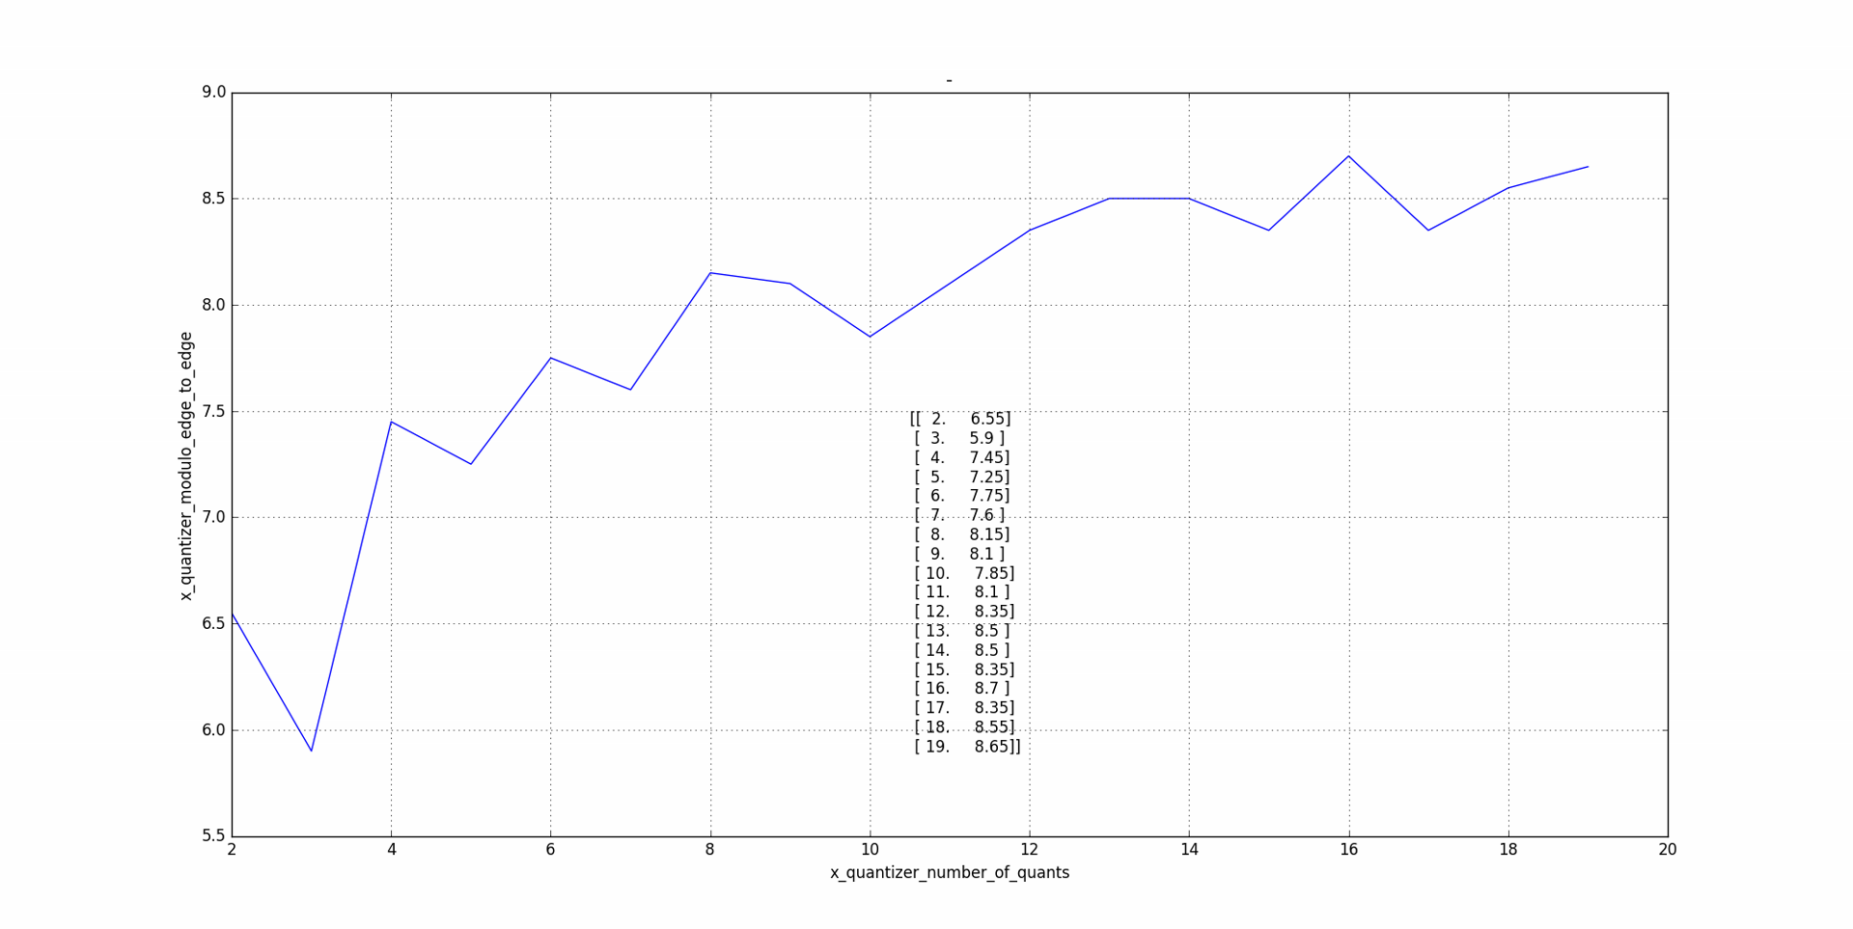
modulo size with alpha

Slide 7
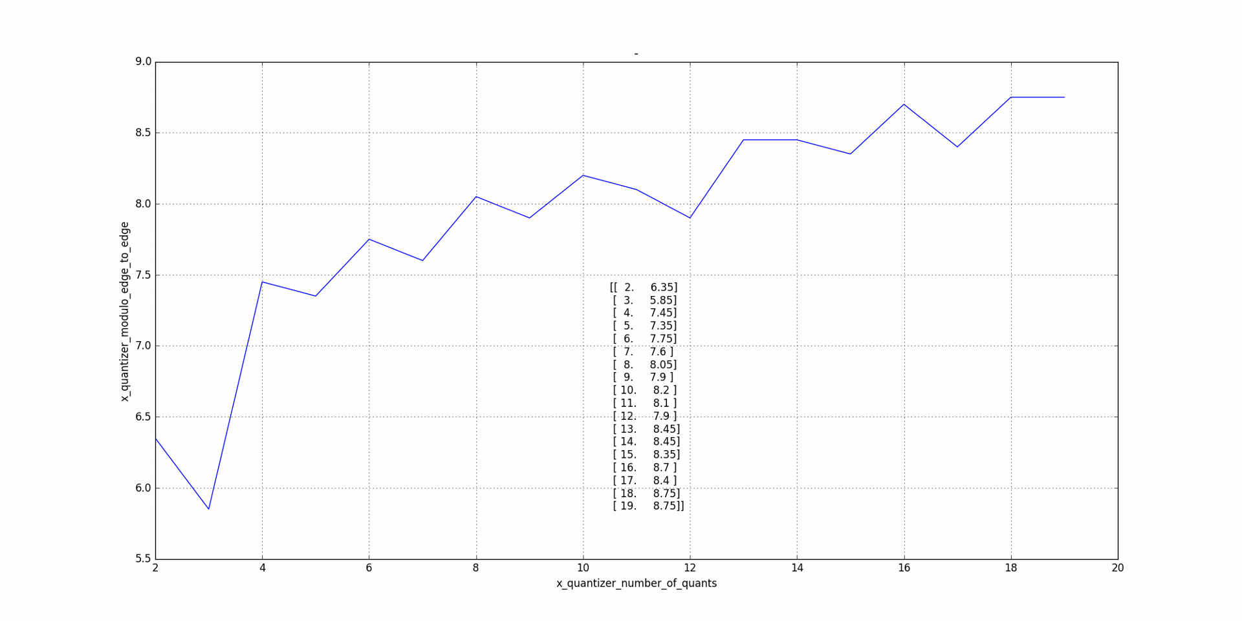
modulo size without alpha

